Slide 1



Analysis of students’ mental health
During the period of online learning
Dataset: 1,005 Students | Python | MongoDB | Power BI
Class: DT2503L-ON
Mentor: Đào Mạnh Thắng
Together We Code Trailblazer
Name Member | Student code
Dương Ngọc Thảo | Student1626510
Nguyễn Hưng Thiên Đức | Student1521204
Nguyễn Thị Thu Thủy | Student1648795

Slide 2



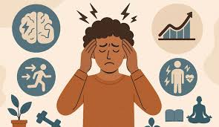
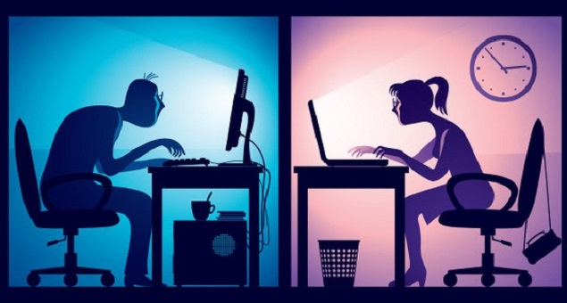
Overview of the topic
Reason for choosing the topic
Whether online learning methods increase psychological pressure.
Unhealthy lifestyles affect the mental state of students during online learning.
33% of students are experiencing high stress, leading to risks to their mental health.
Objectives
Analyze risk factors for mental health.
Identify groups of students at high risk.
Develop a model to predict stress.
Propose effective intervention solutions..
Áp lực kết quả học tập, yếu tố bên ngoài

Slide 3
Dataset & mô tả
Student Mental Health Analysis During Online Learning.
Activities
+ Name
+ Gender
+ Age
+ Education level
Status
+ Stress level
+ Anxious Before Exams
+ Academic performance changes
Student information
+ Daily screen time (hours/day)
+ Sleep duration (hours/day)
+ Physical activity time (hours/week)
Behavior
Demographics
Mental health

Slide 4





Data cleaning and preparation
Data processing workflow:
Input Raw Data
File .csv
Data exploration
Missing values.
Data cleaning
Filling miss values.
1.010 records
10 columns
Removing duplicate values.
Removing noisy outliers.
Standardize data.
Data export
Export cleaned data.csv.
1.005 records.
Inconsistencies in the data.
Duplicate data.
Detecting outliers.
The dataset consists of 1,005 students, collected and managed in a database using MongoDB, combined with the MongoDB aggregation pipeline to generate data queries.

Slide 5

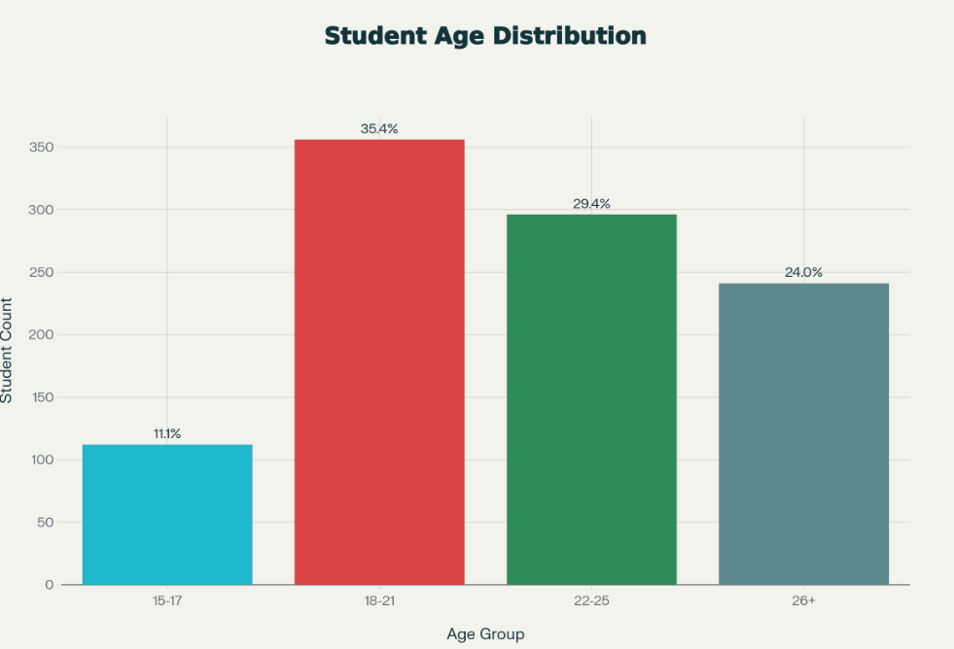

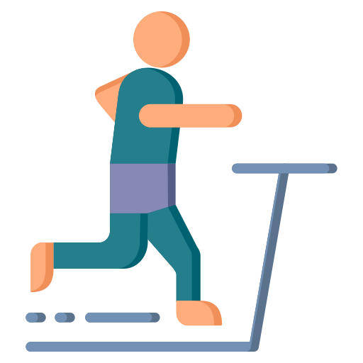


EDA - Distribution & Statistics
Descriptive Statistics:
Screen time (hrs/day)
Mean: 6,93 |Median: 6,90
Min: 2.0 |Max: 15.0| Std: 2.93
Physical Activity (hrs/week)
Mean : 5,22 | Median: 5,00
Min: 0 |Max: 50.0| Std: 3,15
Sleep Duration (hrs)
Mean : 6,48 | Median: 6,50
Min: 3.0 |Max: 12.0| Std: 1.50
Age
Mean : 20.5 | Median: 19
Min: 14 |Max: 40| Std: 5,20

Slide 6
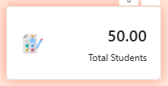
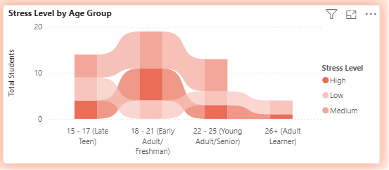
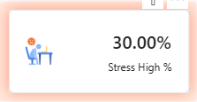
Gender “other” and age affecting stress levels
The “other” gender group shows a high stress level (30%).
In the age groups 15–17, 22–25, and 26+, the number of highly stressed individuals is very small.
The 18–21 age group is the most sensitive period, with large fluctuations in stress levels.

Slide 7
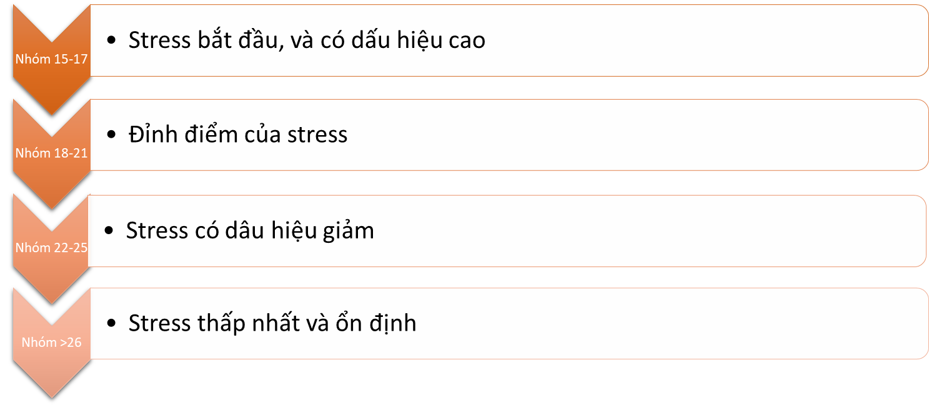
Gender “other” and age affecting stress levels
Specific stress levels by age group

Slide 8



Student Mental Health Infographics
Page 1
Page 2
Student profile & mental health status
Behavior impact analysis
Page 3
Page 4
Academic Performance
Machine learning & risk prediction

Slide 9

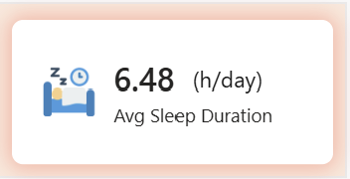
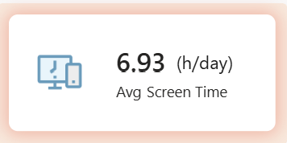
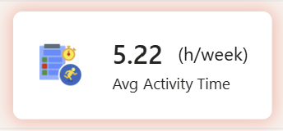
BEHAVIOR IMPACT ANALYSIS (Sleep, Screen, Activity)
Sleep time
Behavior
01
Sleep time acts like a biological shock absorber for emotions and mental health.
Lack of sleep makes stress worse, and vice versa..
Screen time
02
Behavior
Screen time is a factor that stimulates the nervous system..
Prolonged screen time will increase stress.
Activity time
Behavior
03
Activity time is a biological mechanism that helps the body regulate stress.
Sleep → a protective factor for the body against stress
Screen → a factor that causes stress for the body
Activity → a factor that helps regulate stress

Slide 10
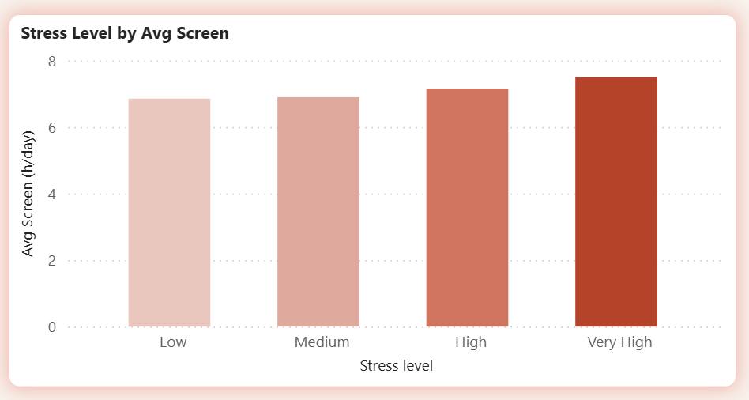
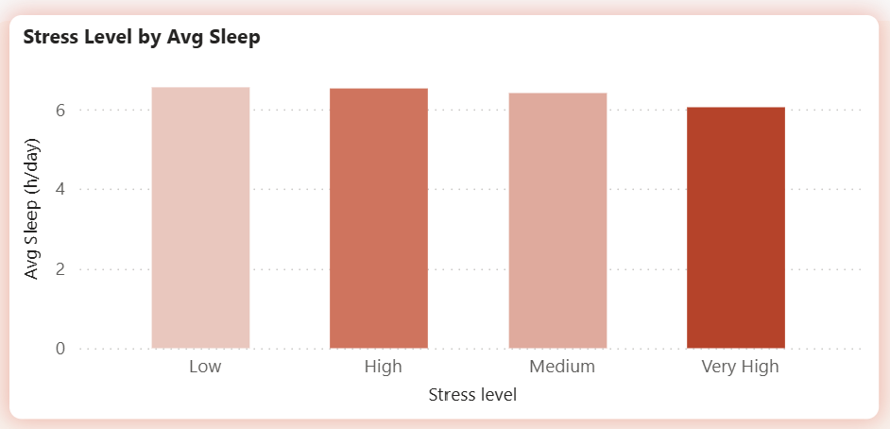
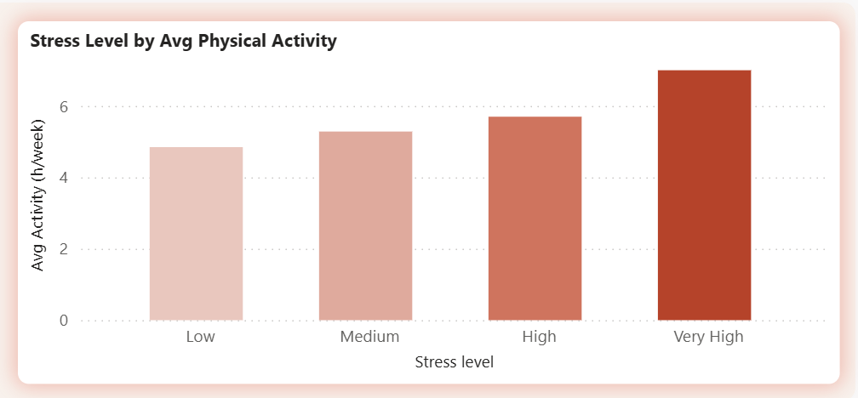
BEHAVIOR IMPACT ANALYSIS (Sleep, Screen, Activity)
High screen time → stress increases.
Sufficient sleep time → stress decreases significantly;
poor sleep time → stress becomes unstable.
Activity time is only effective when sleep is sufficient and screen time is not too high.

Slide 11
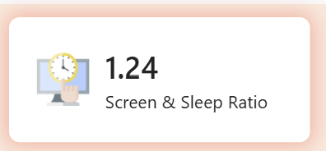
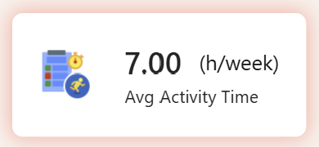
Highest-Stress Student Groups
High screen time makes sleep lose its restorative effect on the nervous system.
Leads to mental fatigue, reduced concentration, poor memory, and impaired emotional balance.
This is the most sensitive warning sign to detect early stress.
Biological rhythm imbalance
Insight
The body is always in a “want to move” state, even without real reasons.
The more you exercise, the more tired you feel, but still do not want to stop, so recovery is slow.
Trying to burn off excess energy but still having trouble sleeping → nervous system exhaustion
High activity as a sign of chronic stress
This is a compensatory behavior because sleep can no longer play its regulatory role.
Reduce screen time → increase sleep → balance the Screen & Sleep ratio.
Sleep ↓ → Stress ↑ → Screen ↑ → Sleep ↓ further → Activity ↑ useless.
Exercise properly, sufficiently, and regularly.
Notes:
Stimulation Load (Tải kích thích)hoạt động, xử lý thông tin, học, social media, dopamine
Recovery Load (Tải phục hồi)ngủ sâu, REM, reset synapse, giảm cortisol
Chỉ cần Screen/Sleep Ratio vượt 1.2–1.4, stress tăng không do nội dung học, mà do mất cân bằng sinh học.
Đây là vùng mà nhiều sinh viên không nhận ra:
“Em ngủ đủ mà sao ngày sau vẫn mệt?”
“Em học không vô, dễ cáu, nhưng không thấy mình stress lắm.”
➡ Chính vì Sleep đã mất tác dụng bảo vệ, do Screen Time phá cấu trúc giấc ngủ (sleep architecture).
“Mệt nhưng không ngủ, mệt nhưng vẫn dùng screen, stress mà không hiểu vì sao, mất khả năng đưa ra quyết định tốt, dễ cáu, dễ buồn, dễ nản”

Slide 12
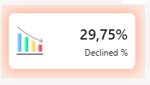
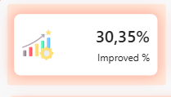


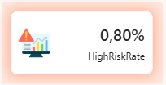
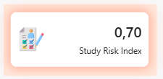
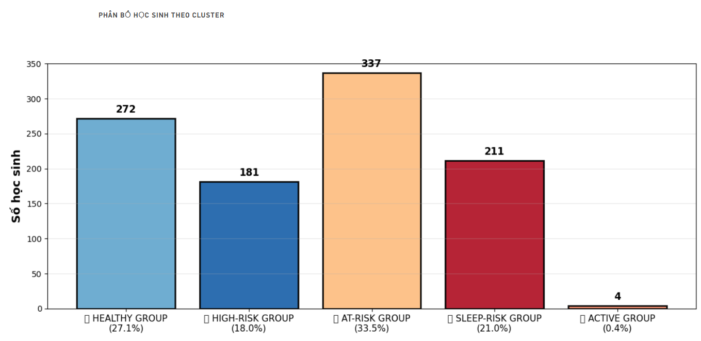
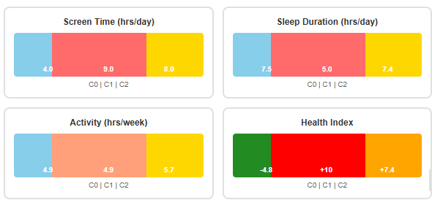

Insight from Analysis
One third of students (337/1005) are in a “danger transition” state – a high‑risk group.
Danger signs:
Screen time: > 8 hrs/day.
Sleep duration: < 5 hrs/day.
Physical Activity: < 2 hrs/week.
Health Index +10 => Dangerous.
Phân cụm nhóm At Risk:
Cluster 1 189 (56%) – High stress
Cluster 2 148 (44%) – Moderate stress
👉 These two clusters are dangerous

Slide 13


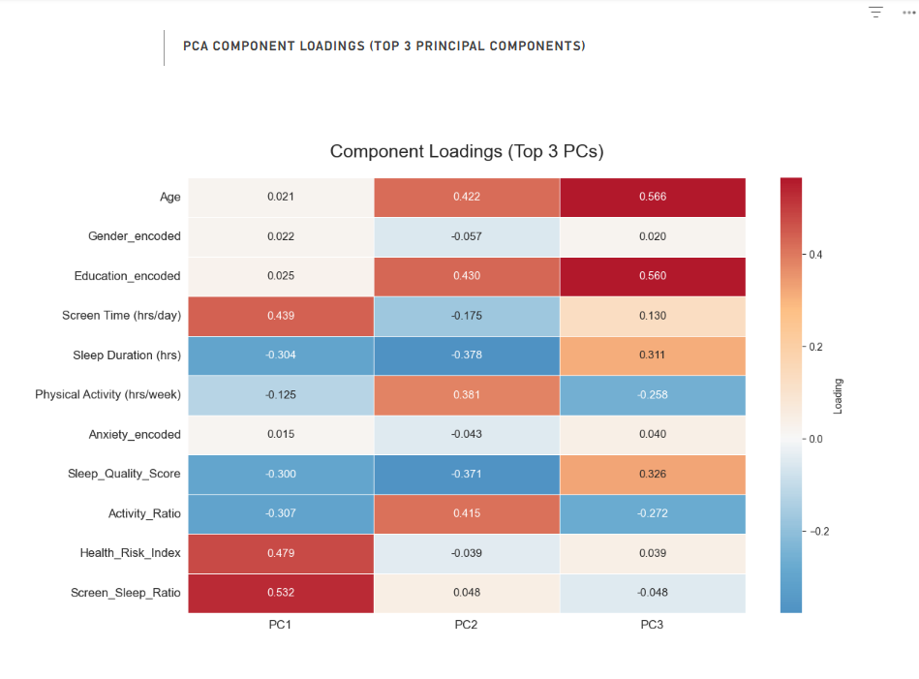




Insight from Analysis
DETAILED FACTORS & URGENT SOLUTIONS
PCA: 3 key factors influencing at‑risk students
SOLUTIONS
Factor 1: Screen Time & Sleep
📱 Screen Time: Strong positive correlation.
😴 Sleep Duration: Strong negative correlation.
👉At-Risk students use screens a lot → sleep less → stress increases.
Reduce time spent on screens.
Limit phone use, turn off notifications, reduce gaming.
Rebalance sleep time.
Factor 2: Social factors
Gender (other)
Age (18-21)
👉Social pressure
Organize psychological counseling sessions.
Connect students with similar circumstances.
Balance study and life.
Nhân Tố 3 : Academic pressure
Study productivity
Study time
👉 Study methods
Provide 1‑to‑1 academic counseling.
Change study styles and methods.
Manage time effectively and with discipline

Slide 14

Kết Luận & Hành Động
📋 Kết Luận Chính:
Stress không đơn chiều: Là kết hợp hành vi + tuổi tác + áp lực xã hội
Nhóm nguy cơ rõ ràng: Giới tính "Other" , 18-21 tuổi cần hỗ trợ ưu tiên
Giải pháp phải toàn diện: Không chỉ 1 yếu tố mà kết hợp ngủ + vận động + tâm lý
1/3 sinh viên đang ở "trạng thái chuyển tiếp" - cần can thiệp ngay
🎯 Hành Động Ngay:
✔️ Xây dựng hệ thống cảnh báo sớm (Screen Time + Sleep + Activity + Test Score + Psychology)
✔️ Workshop về quản lý stress & lối sống lành mạnh
✔️ Hỗ trợ tâm lý đặc biệt cho nhóm "Other" & nữ sinh 19-21 tuổi và tạo môi trường lạnh mạnh
✔️ Theo dõi nhóm "Improved" để tránh suy nhược sức khỏe trong dài hạn

Slide 15

CẢM ƠN HỘI ĐỒNG VÀ CÁC BẠN ĐÃ LẮNG NGHE

